Slide 1
Measures of Central Tendency
Chap 3-<number>

Slide 2
Topics
Measures of central tendency and shape
  Mode, geometric mean, harmonic mean
  Quartiles
  Symmetric and skewed distributions
Chap 3-<number>

Slide 3
Summary Measures
Describing Data Numerically
Central Tendency
Quartiles
Variation
Shape
Arithmetic Mean
Range
Skewness
Median
Interquartile Range
Mode
Variance
Geometric Mean
Standard Deviation
Harmonic Mean
Coefficient of Variation
Chap 3-<number>

Slide 4
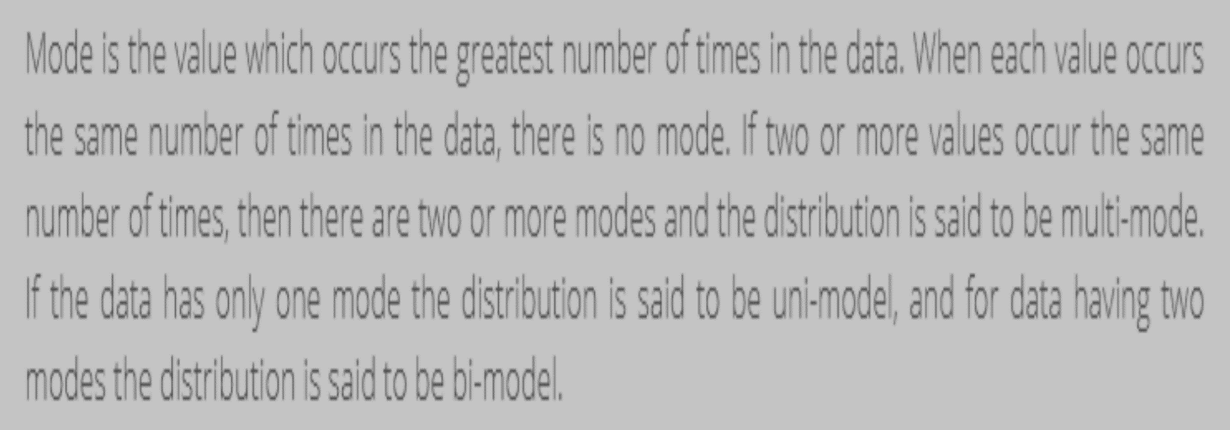

Mode
Chap 3-<number>

Slide 5
Mode
A measure of central tendency
Value that occurs most often
Not affected by extreme values
Used for either numerical or categorical (nominal) data
There may be no mode
There may be several modes
0 1 2 3 4 5 6 7 8 9 10 11 12 13 14
0 1 2 3 4 5 6
No Mode
Mode = 9
Chap 3-<number>

Slide 6
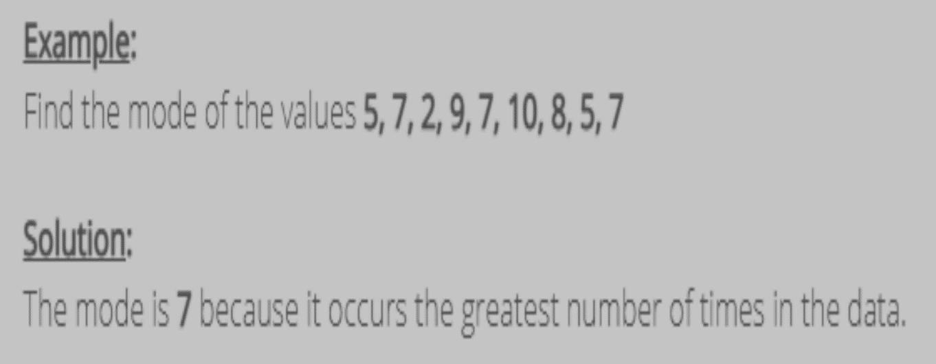
Mode
Chap 3-<number>

Slide 7
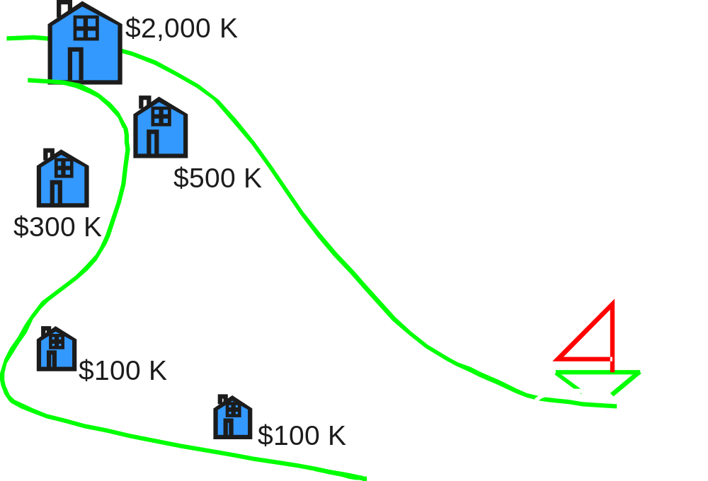

Review Example
Five houses on a hill by the beach
House Prices:
$2,000,000
500,000
300,000
100,000
100,000
Chap 3-<number>

Slide 8
Review Example:
Summary Statistics
House Prices:
$2,000,000
500,000
300,000
100,000
100,000
Sum $3,000,000
Mean: ($3,000,000/5)
= $600,000
Median: middle value of ranked data
= $300,000
Mode: most frequent value
= $100,000
Chap 3-<number>

Slide 9
Which measure of location is the “best”?
Mean is generally used, unless extreme values (outliers) exist
Then median is often used, since the median is not sensitive to extreme values.
  Example: Median home prices may be reported for a region – less sensitive to outliers
Chap 3-<number>

Slide 10
Quartiles
Quartiles split the ranked data into 4 segments with an equal number of values per segment
25%
25%
25%
25%
Q1
Q2
Q3
The first quartile, Q₁, is the value for which 25% of the observations are smaller and 75% are larger
Q₂ is the same as the median (50% are smaller, 50% are larger)
Only 25% of the observations are greater than the third quartile
Chap 3-<number>

Slide 11
Quartile Formulas
Find a quartile by determining the value in the appropriate position in the ranked data, where
First quartile position: Q₁ = (n+1)/4
Second quartile position: Q₂ = (n+1)/2 (the median position)
Third quartile position: Q₃ = 3(n+1)/4
where n is the number of observed values
Chap 3-<number>

Slide 12
Quartiles
Example: Find the first quartile
Sample Data in Ordered Array: 11 12 13 16 16 17 18 21 22
(n = 9)
Q₁ is in the (9+1)/4 = 2.5 position of the ranked data
so use the value half way between the 2nd and 3rd values,
so Q₁ = 12.5
Q₁ and Q₃ are measures of noncentral location
Q₂ = median, a measure of central tendency
Chap 3-<number>

Slide 13
Quartiles
(continued)
Example:
Sample Data in Ordered Array: 11 12 13 16 16 17 18 21 22
(n = 9)
Q₁ is in the (9+1)/4 = 2.5 position of the ranked data,
so Q₁ = 12.5
Q₂ is in the (9+1)/2 = 5th position of the ranked data,
so Q₂ = median = 16
Q₃ is in the 3(9+1)/4 = 7.5 position of the ranked data,
so Q₃ = 19.5
Chap 3-<number>

Slide 14
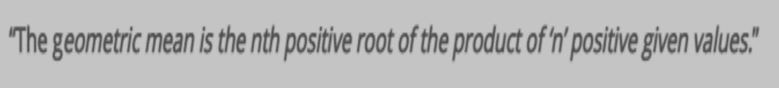
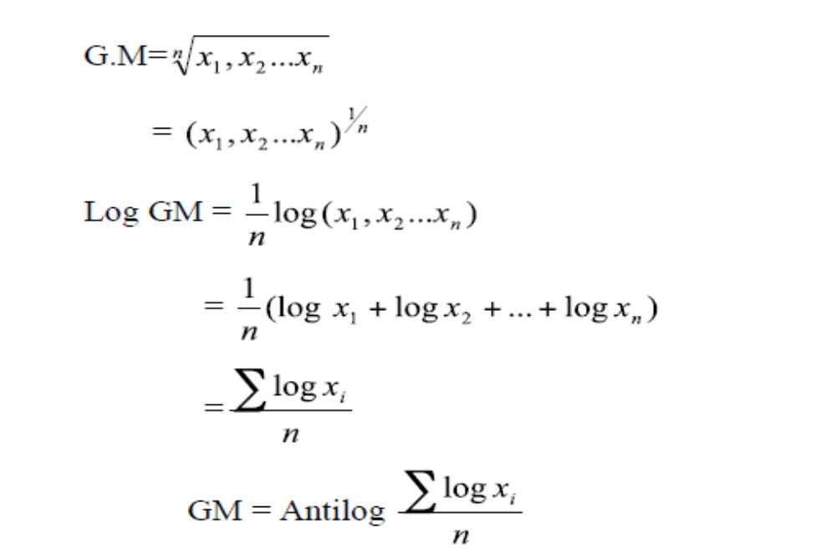
Geometric Mean
Chap 3-<number>

Slide 15
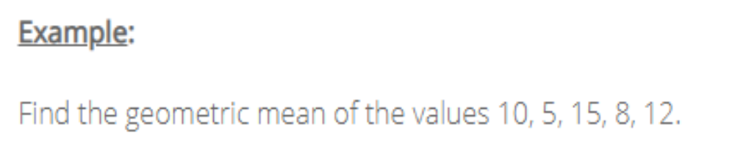
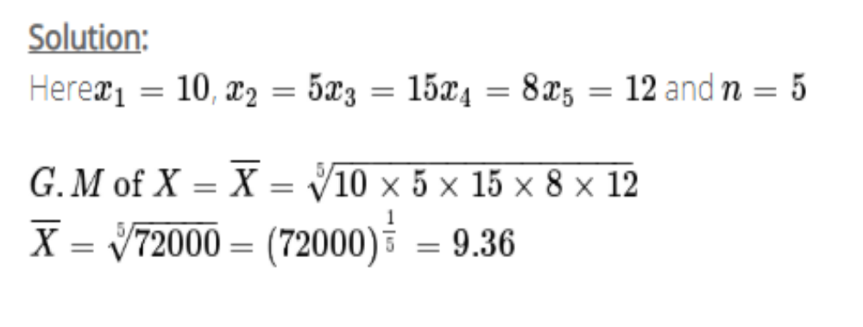
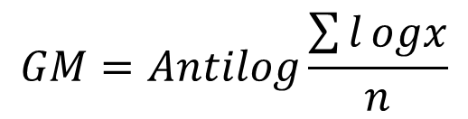
Geometric Mean
X | logx
5 | 0.6987
8 | 0.9031
10 | 1
12 | 1.0792
15 | 1.1761
total | 4.8573
G.M=Antilog 4.8573/5
=Antilog 0.9715
=9.365
Chap 3-<number>

Slide 16
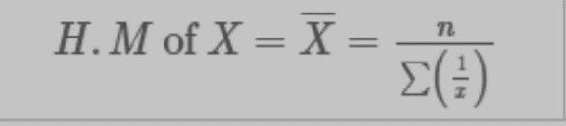
Harmonic Mean
Reciprocal of A.M of reciprocal of values
Used for averaging rates, ratios (average speed)
Chap 3-<number>

Slide 17
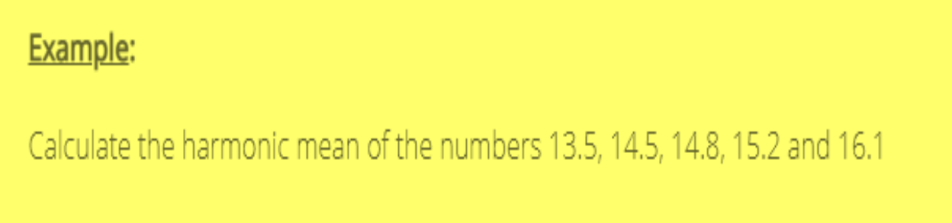
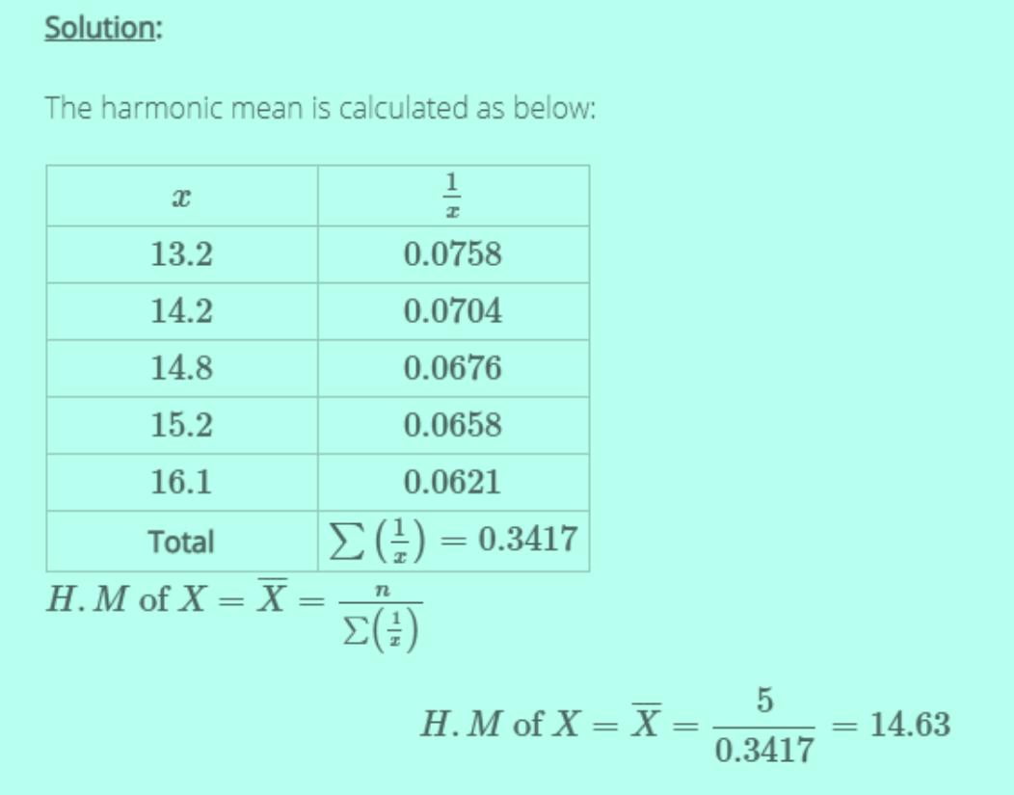
Chap 3-<number>

Slide 18
Shape of a Distribution
Describes how data are distributed
Measures of shape
  Symmetric or skewed
Left-Skewed
Symmetric
Right-Skewed
Mean < Median
Mean = Median
Median < Mean
Chap 3-<number>

Slide 19
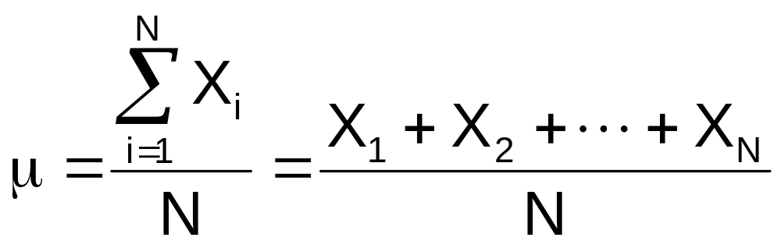
Numerical Measures for a Population
Population summary measures are called parameters
The population mean is the sum of the values in the population divided by the population size, N
Where
μ = population mean
N = population size
X_{i} = i^{th} value of the variable X
Chap 3-<number>

